Slide 1

PE 1 3.2 Loops
Programming Logic

Slide 2

Objectives
By the end of this lesson, you will be able to:
Run conditional loops using the while statement
Create count-based loops using the for statement
Avoid the dreaded infinite loop!

Slide 3
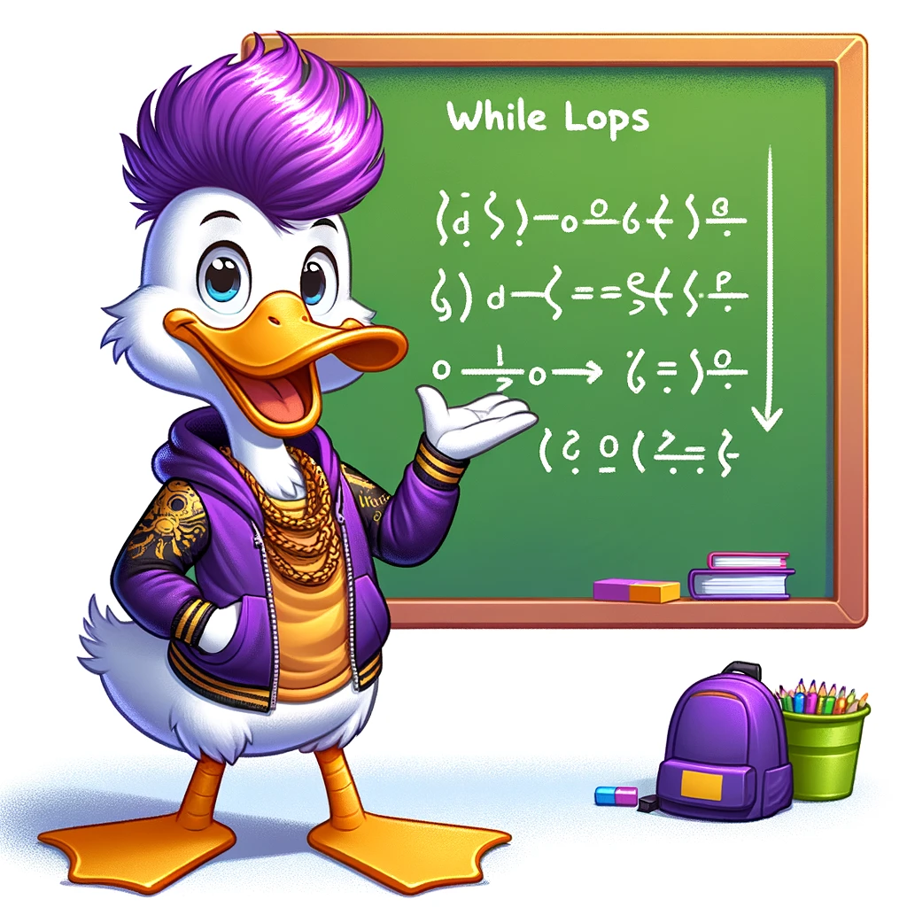
While Loop steps
Set an initial value to the variable that will be checked
Check the variable with a while statement
Do something!
Increment the variable! OR Change a flag value!

Slide 4

Sample while loop
count = 0
while count < 5:
print("Loop iteration", count)
count += 1 # Increment count
print("Count is now", count)

Slide 5

For loop with range, 3 arguments
).
for i in range(1, 10, 2):
print(i)
1 – the starting number
10 – the ending number (not included!)
2 – the increment or step value

Slide 6
For loop with 2 arguments
With two arguments you have the start and the end (not included) with a default step of 1
# two arguments
for i in range(5, 8):
print(i)

Slide 7

break
# break
for i in range(1, 10):
if i == 5:
break
print(i)
Break can stop a loop before it loops through all items
– it completely leaves the loop

Slide 8
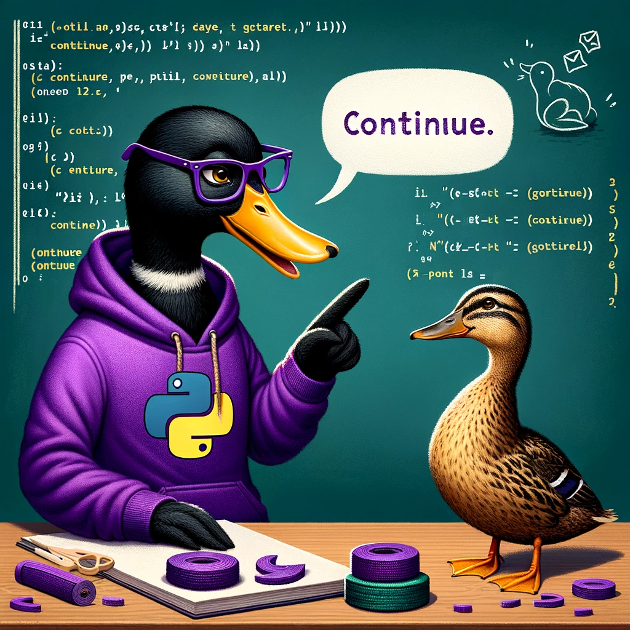
Continue
# Continue
for i in range(1, 10):
if i % 2 == 0:
continue
print(i)
The "continue" statement skips the current iteration of a loop and proceeds to the next one.

Slide 9
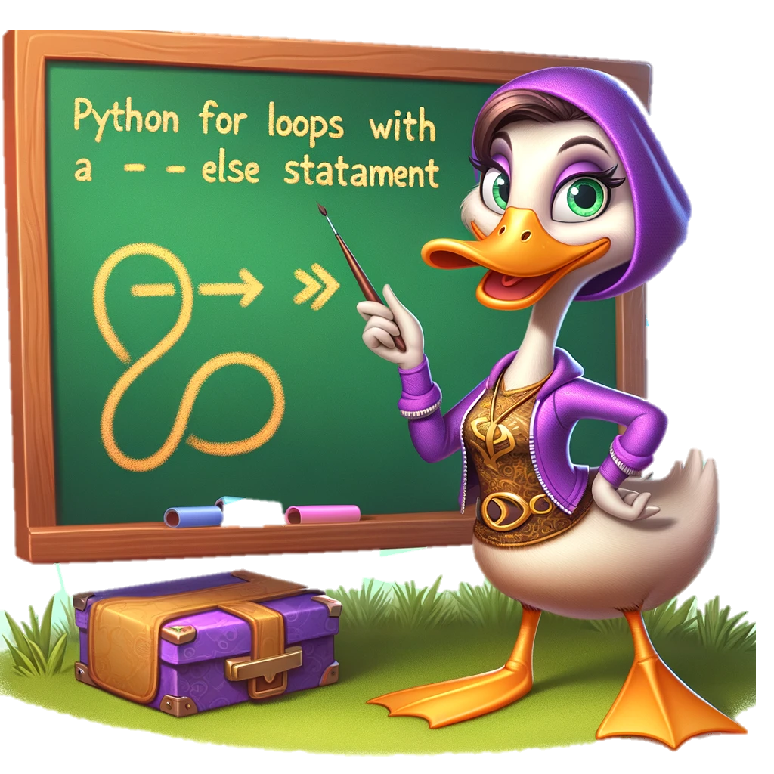
Else with a loop
It will execute at the end of a loop UNLESS interrupted by a break
# Else
for i in range(5):
if i == 3:
break
else:
print("Loop completed without break")

